Slide 1



Financial Accounting (FI) &
Management Accounting (CO)
Topic 5 – Financial Accounting
SAP University Alliances
Version 1.0
Product
SAP ERP 6.0
Global Bike Inc.
Level
Beginner

Slide 2
Goal of FI
Financial accounting is designed to collect the transactional data that provides a foundation for preparing the standard reports
In general, these reports are primarily, but not exclusively, directed at external parties
Standard reports include:
  Balance Sheet
  Income Statement
  Statement of Cash Flows

Slide 3
Target Audience
Internal
  Executives
  Senior Management
  Administrative Staff
  Employees
External
  Legal Authorities
  Banks
  Auditors
  Shareholders
  Insurance
  Tax Authorities
  Media
  Financial Analysts

Slide 4
Organizational Objects
These represent the legal and/or organizational views of an enterprise
They form a framework that supports the activities of a business in the manner desired by management
Permit the accurate and organized collection of business information
Support the development and presentation of relevant information in order to enable and support business decisions
Organizational Data:
  Client & Company Code
Master Data
  Chart of Account
  General Ledger Accounts (G/L Accounts)

Slide 5
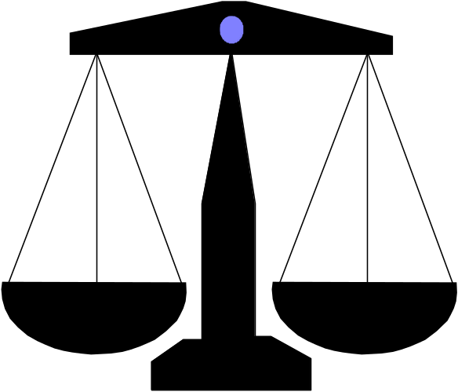
Company Code
Represents an independent legal accounting unit
Balanced set of books, as required by law, are prepared at this level
A client may have more than one company code
  United States
  United Kingdom
  South America
  Canada
  Germany
Assets
Liabilities &
Owners Equity

Slide 6
Chart of Accounts
A classification scheme consisting of a group of general ledger (G/L) accounts.
E.g. Revenue, COGS, Tax, general expenses, Fixed Asset, Current asset and etc.
A chart of accounts provides a framework for the recording of values to ensure an orderly rendering of accounting data.
The G/L accounts it contains are used by one or more company codes.
FI-1

Slide 7
General Ledger (G/L) Accounts
The unique combination of Company Code and Chart of Account creates a data storage area called a General Ledger
The General Ledger contains a listing of each account in the Chart of Accounts and the respective account balance
It is utilized in the preparation of financial accounting statements
FI-2

Slide 8
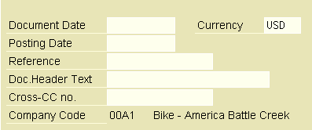

Posting a G/L Entry
What are the key information required in a G/L entry?
FI-3

Slide 9
G/L Account Summary
Account number 100100 Bank Account
Company code 00A1
Period Debit Credit DC bal. Balance
C/f bal. 750,000.00
Period 1 5,250.00 3,540.00 1,710.00 751,710.00
Period 2 25,000.00 15,000.00 10,000.00 761,710.00
FI- 4 to 10

Slide 10
Balance Sheet
Presentation of an organization’s Assets, Liabilities, and Equity at a point in time
Assets: What the company owns
Liabilities: What the company owes
Equity: The difference between Assets and Liabilities
Assets = Liabilities + Equity

Slide 11
Balance Sheet – Sample
Assets
  Cash 1,000
  Accounts Receivable 3,000
  Equipment 500
Total Assets 4,500
Liabilities
  Accounts Payable 750
  Taxes Payable 250
Total Liabilities 1,250
Equity
  Common Stock 2,000
  Retained Earnings 250
Total Equity 2,250
Total Liabilities
  and Equity 4,500

Slide 12
Income Statement
Presentation of an organization’s Revenues and Expenses for a given period of time (e.g., monthly, quarterly, or yearly)
Revenues, in a simple sense, are inflows of cash as a result of selling activities or the disposal of company assets
Expenses, in a simple sense, are outflows of cash or the creation of liabilities to support company operations
Revenues - Expenses = Net Income

Slide 13
Income Statement – Sample
Revenue
  Sales 11,000
  Deductions 750
Total Revenue 10,250
Operating Expenses
  Cost of Goods Sold 4,500
  Operating Expenses 3,750
Total Expenses 8,250
Net Income Before Taxes 2,000
Taxes 750
Net Income 1,250

Slide 14

Statement of Cash Flows
Considers the associated changes, both inflows and outflows, that have occurred in cash – arguably the most important of all assets – over a given period of time (e.g., monthly, quarterly, or annually)

Slide 15
Goal of Management Accounting
Managerial accounting
- Also known as “controlling”
- Designed to collect the transactional data that provides a foundation for preparing internal reports that support decision-making within the enterprise
These reports are exclusively for use within the enterprise and include:
  Cost center performance
  Profit center performance
  Budgets analyses

Slide 16
Target Audience
Executives
Senior Management
Department Managers
Controllers
Cost Accountants

Slide 17
Nature of Management Accounting
It is the internal account. The reports generated are meant for internal use, mainly to support management’s decision making.
It is not required by law..
The report formats are flexible. There are not standard formats of the reports to follow.
Management Accounting mainly focus on costs (and sometimes revenues).

